Slide 1
MediCall
Fall 2018: BME Senior Design
Deepthi Nacharaju
Lizbeth Leapo
Haeryn Kim

Slide 2
Introduction
Context
Nurse call system
Physical Disabilities
Prototype
Cycle 2 Objectives
Challenges
Next Steps

Slide 3
Specifications
Time it takes patient to find and use the device
Percentage of false positives
Wires from device to power
Number of different settings/modes to adapt to varying hand dexterities
Transmission Range
Battery Life
Water Resistance
Cost of Device
Weight of Device
Notes:
Removed this spec because it was no longer relevant

Slide 4
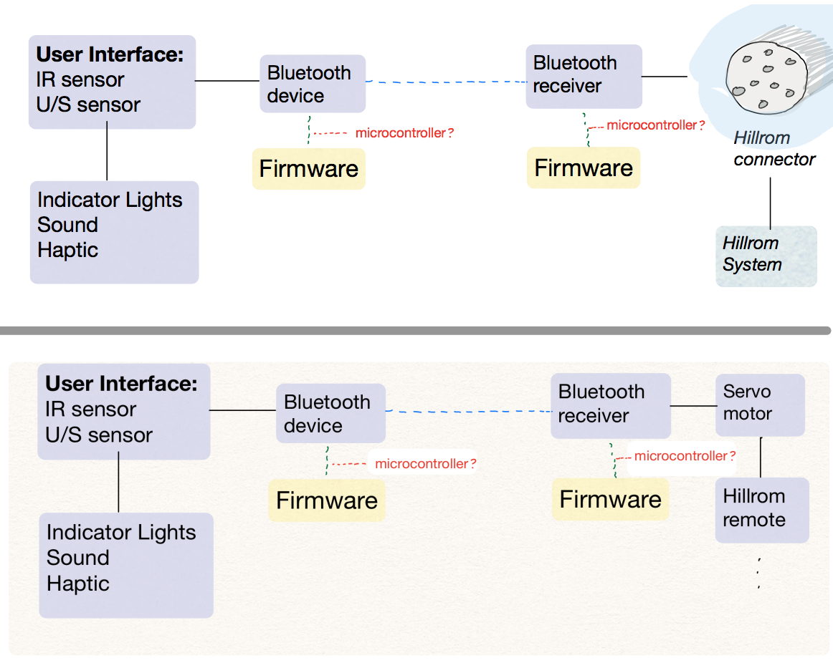
Objectives: Functional Decomposition

Slide 5
Objectives: Battery vs Main Power Line
Haeryn

Slide 6
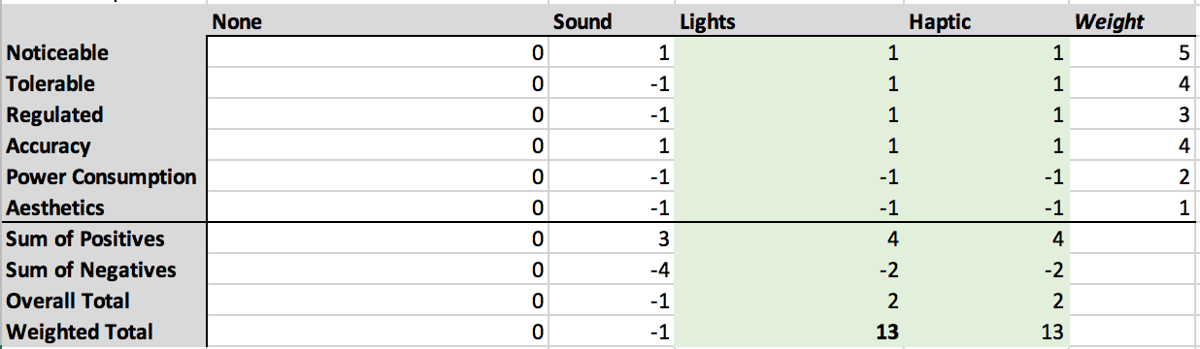
Objectives: User Alert

Slide 7
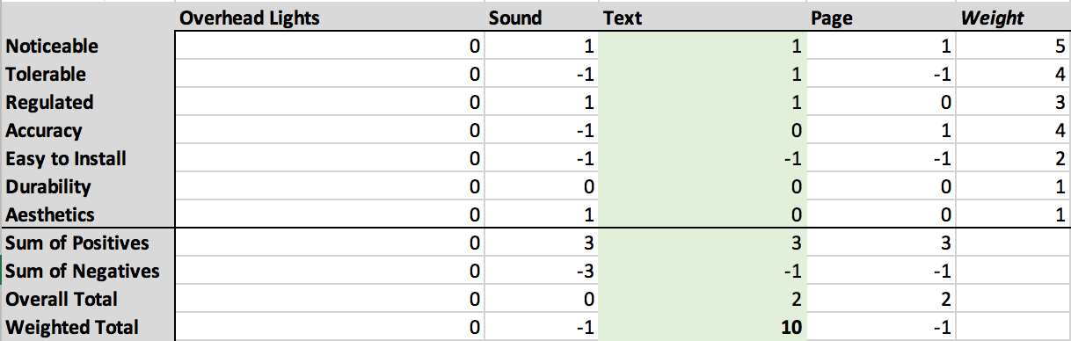
Objectives: Nurse Alert

Slide 8
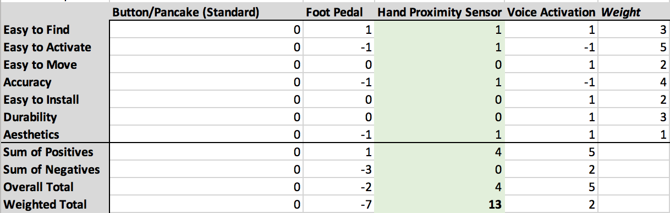
Objectives: User Input

Slide 9
Objectives: Bluetooth vs Wifi
Haeryn’s beautiful report

Slide 10
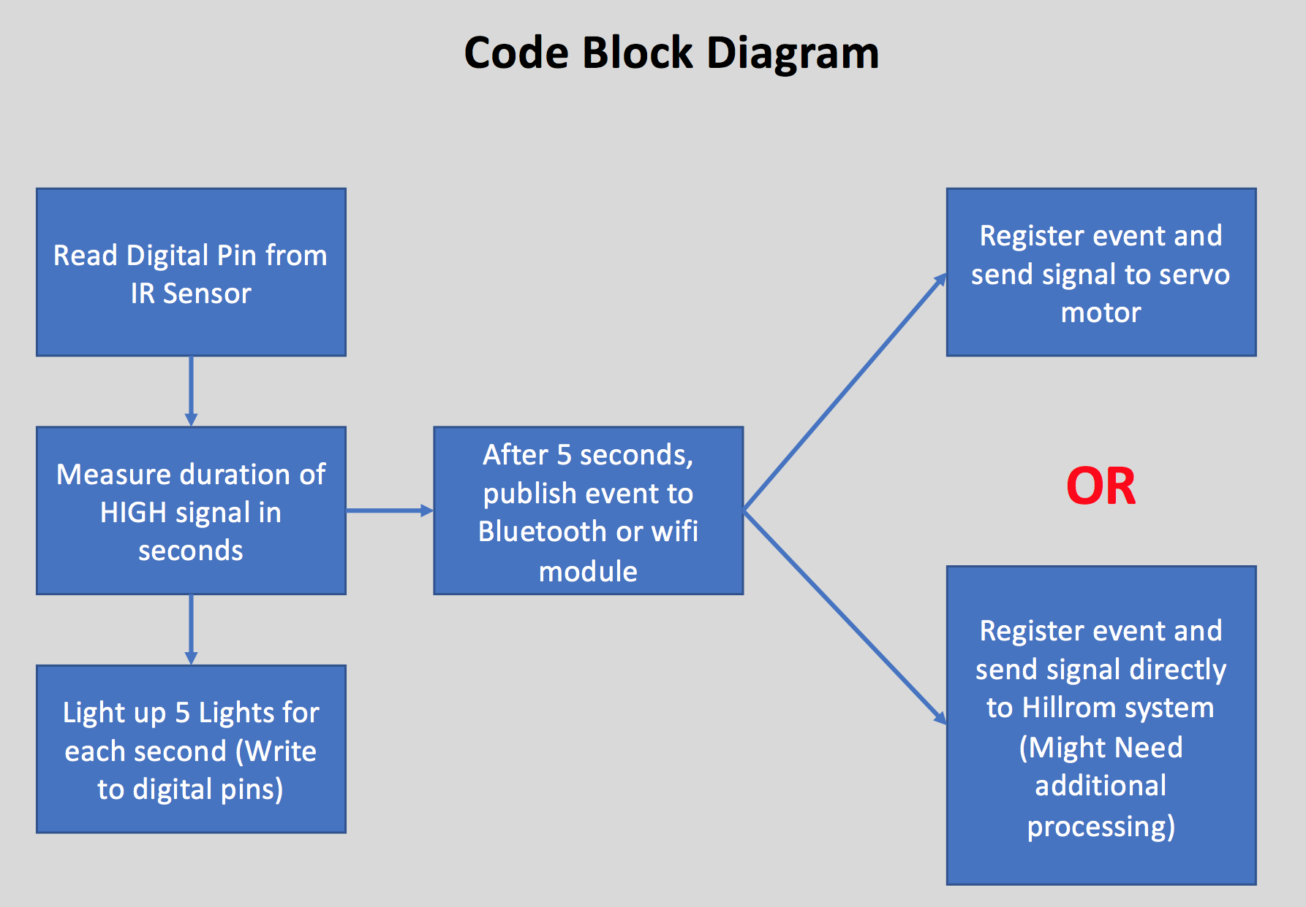
Prototyping Objectives: Code Block Diagram

Slide 11
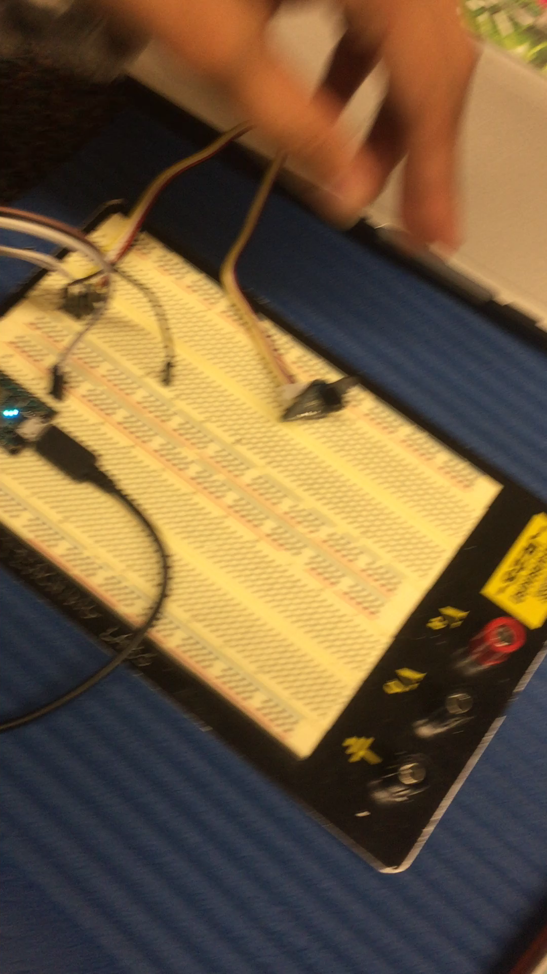
Prototyping Objectives: Working Device

Slide 12
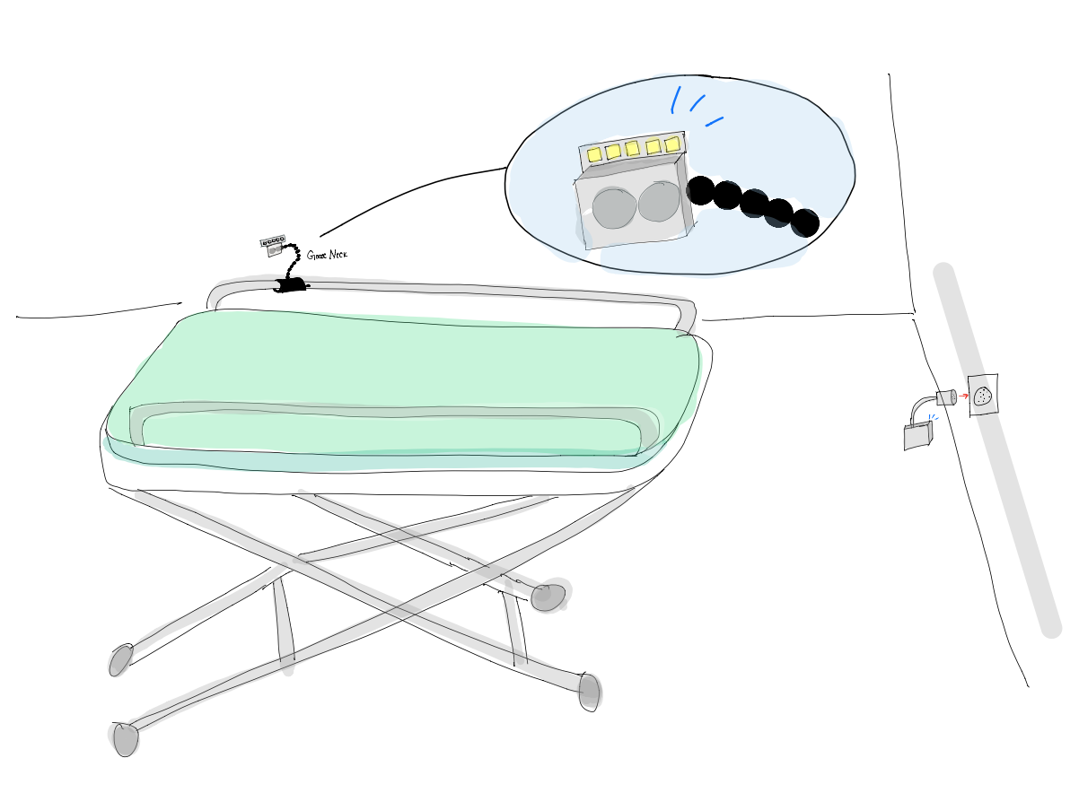
Prototyping Objectives: Drawings
Notes:
Liz add screenshots of solidworks files

Slide 13
Next Steps and Conclusion
Rev 2
Hillrom Communication
Motor
Lights
Rev 1
3D Prints of housing and clamps
Order the goose neck

